Slide 1

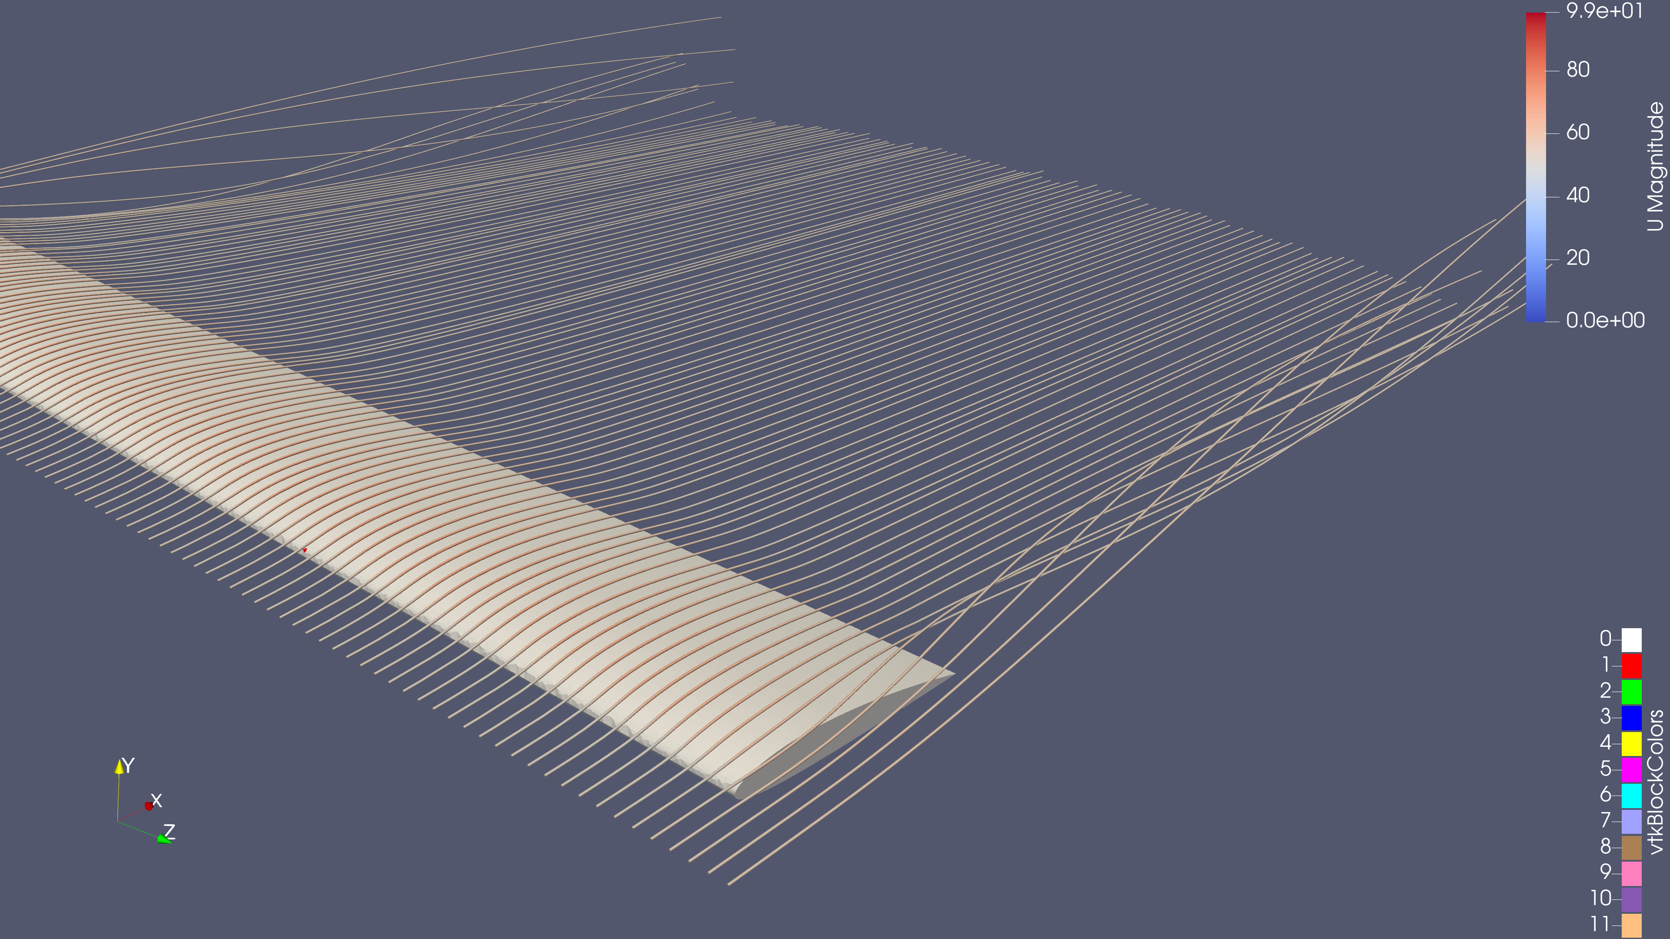
Open-source CFD for FSAE
A NACA 2412 wing study
Gmsh / OpenFOAM / ParaView
01
Notes:
Sources: .\cfd\naca2412\naca2412_run; system/controlDict, system/fvSchemes, system/fvSolution, constant/momentumTransport, constant/physicalProperties, 0/U. Actual case: steady incompressible RANS kOmegaSST with wall functions, SIMPLE, finite AR6 wing at approximately 5 degrees. All flow images must come from the reconstructed 2000 result. The time label is a steady iteration index, not 2000 seconds of physical flow. Cover image: user ParaView export, U magnitude stream tubes and wing, iteration 2000. Visual identity: user-supplied Bulldog Motorsports logo; MSU maroon #5D1725, white and gray. Color reference: https://www.brand.msstate.edu/assets/index.php .

Slide 2
The CFD workflow
Gmsh
OpenFOAM
ParaView
Import CAD and control the mesh
Solve the flow on the CPU
Inspect and explain the results
Scripted prism layers
Local wake refinement
Named boundary patches
Convert and check the mesh
Run in parallel
Track residuals and forces
Velocity slices and streamlines
Vortex and wall diagnostics
Reusable visualization states
Repeatable files connect each stage, from CAD to the team review.
02
Notes:
Sources: .\cfd\naca2412\naca2412_run; system/controlDict, system/fvSchemes, system/fvSolution, constant/momentumTransport, constant/physicalProperties, 0/U. Actual case: steady incompressible RANS kOmegaSST with wall functions, SIMPLE, finite AR6 wing at approximately 5 degrees. All flow images must come from the reconstructed 2000 result. The time label is a steady iteration index, not 2000 seconds of physical flow. Capabilities: https://gmsh.info/ ; https://openfoam.org/ ; https://docs.paraview.org/en/v5.11.2/ . The unsuccessful SimScale upload led to this local route; it does not establish a limitation of SimScale generally. Visual identity: user-supplied Bulldog Motorsports logo; MSU maroon #5D1725, white and gray. Color reference: https://www.brand.msstate.edu/assets/index.php .

Slide 3
The benchmark wing
NACA 2412
0.9144 m chord
5.4864 m full span
5.0168 m² reference area
Angle of attack ≈ 5°
Aspect ratio 6
Reynolds number 3.25 million
Comparison: NACA Report 460
Figure 18, finite-wing curves
Freestream speed 53.3 m/s
This isolated wing is a benchmark for the process before an FSAE aero package.
03
Notes:
Sources: .\cfd\naca2412\naca2412_run; system/controlDict, system/fvSchemes, system/fvSolution, constant/momentumTransport, constant/physicalProperties, 0/U. Actual case: steady incompressible RANS kOmegaSST with wall functions, SIMPLE, finite AR6 wing at approximately 5 degrees. All flow images must come from the reconstructed 2000 result. The time label is a steady iteration index, not 2000 seconds of physical flow. Geometry source: naca2412_mesh4simscale_v2.geo. NACA Report 460 Figure 18, printed page 14, https://ntrs.nasa.gov/api/citations/19930091108/downloads/19930091108.pdf#page=16. The experiment uses a 5 inch chord and 30 inch span. We match AR and Reynolds number using a larger model at lower ambient-air speed. Historical turbulence, transition and trailing-edge details are not an exact match. Visual identity: user-supplied Bulldog Motorsports logo; MSU maroon #5D1725, white and gray. Color reference: https://www.brand.msstate.edu/assets/index.php .

Slide 4
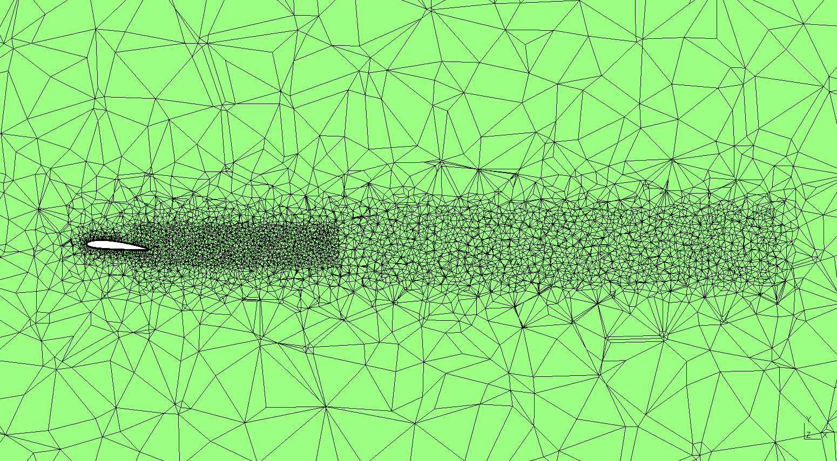
Gmsh: control where the cells go
2.03 million
total volume cells
350,352
prism cells in
12 wall layers
Fine cells near the wing, through the wake and along both tip corridors.
04
Notes:
Sources: .\cfd\naca2412\naca2412_run; system/controlDict, system/fvSchemes, system/fvSolution, constant/momentumTransport, constant/physicalProperties, 0/U. Actual case: steady incompressible RANS kOmegaSST with wall functions, SIMPLE, finite AR6 wing at approximately 5 degrees. All flow images must come from the reconstructed 2000 result. The time label is a steady iteration index, not 2000 seconds of physical flow. Mesh source: v2.geo and the supplied checkMesh output. 2,029,549 cells = 1,679,077 tetrahedra + 350,352 prisms + 120 pyramids. 12 prism layers, full first height 0.029 inch = 0.7366 mm, growth 1.15. Distance refinement, near wake for 3 chords, broad wake/tip corridors for 10 chords. Domain upstream 10c, downstream 20c. Physical groups exported as ASCII MSH 2.2 with SI coordinates, converted by gmshToFoam. Do not quote the earlier AR4/10-layer walkthrough as the final mesh. Visual identity: user-supplied Bulldog Motorsports logo; MSU maroon #5D1725, white and gray. Color reference: https://www.brand.msstate.edu/assets/index.php .

Slide 5
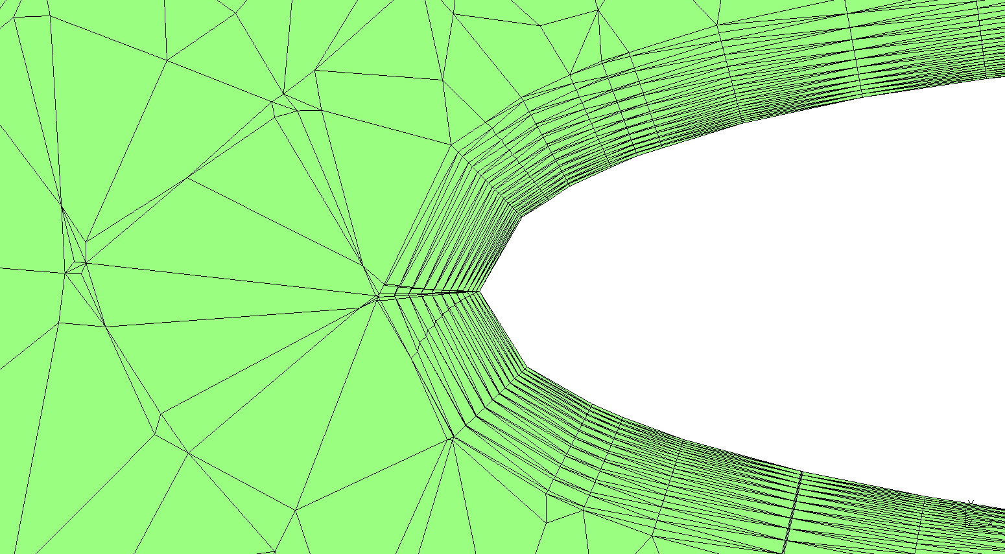
Prism layers resolve the near-wall flow
12 layers
0.737 mm
first-cell thickness
1.15×
layer growth
A close-up at the leading edge shows the layered mesh connecting to the outer volume.
05
Notes:
Sources: .\cfd\naca2412\naca2412_run; system/controlDict, system/fvSchemes, system/fvSolution, constant/momentumTransport, constant/physicalProperties, 0/U. Actual case: steady incompressible RANS kOmegaSST with wall functions, SIMPLE, finite AR6 wing at approximately 5 degrees. All flow images must come from the reconstructed 2000 result. The time label is a steady iteration index, not 2000 seconds of physical flow. Source: user Gmsh leading-edge boundary-layer section and naca2412_mesh4simscale_v2.geo. There are 12 layers with full first-cell thickness 0.029 inch (0.7366 mm) and a thickness growth ratio of 1.15. These are mesh dimensions, not a measured physical boundary-layer thickness. Wall-function suitability is assessed using the solved y+ field, shown later. Visual identity: user-supplied Bulldog Motorsports logo; MSU maroon #5D1725, white and gray. Color reference: https://www.brand.msstate.edu/assets/index.php .

Slide 6
A complete solve on a laptop
1 h 56 min
2,000
Successful solver wall time
steady iterations
Iterations 1–500: 6 MPI processes, 30.8 min
Iterations 501–2000: 8 MPI processes, 85.7 min
Intel i7-13620H laptop, 24 GB RAM
Elapsed solve time excludes setup, meshing, post-processing and the unsuccessful restart.
06
Notes:
Sources: .\cfd\naca2412\naca2412_run; system/controlDict, system/fvSchemes, system/fvSolution, constant/momentumTransport, constant/physicalProperties, 0/U. Actual case: steady incompressible RANS kOmegaSST with wall functions, SIMPLE, finite AR6 wing at approximately 5 degrees. All flow images must come from the reconstructed 2000 result. The time label is a steady iteration index, not 2000 seconds of physical flow. Timing comes from ClockTime at the end of each accepted run: log.foamRun 414 s; log.foamRun.continue 471 s; log.foamRun.resume 962 s; log.foamRun.8proc.fixed 5139 s. Sum 6986 s = 1 h 56 min 26 s. Excludes failed restart log.foamRun.8proc, setup, meshing, conversion, decomposing/reconstructing, idle time, and ParaView. Hardware is user supplied: Intel Core i7-13620H, 10 cores /16 logical processors, 24 GB RAM. MPI process count is not a physical-core assignment. No GPU solver acceleration used. No trustworthy meshing wall time is retained. Visual identity: user-supplied Bulldog Motorsports logo; MSU maroon #5D1725, white and gray. Color reference: https://www.brand.msstate.edu/assets/index.php .

Slide 7
Residuals across all 2,000 iterations
Initial equation residuals. The restart at iteration 500 also changed solver settings.
07
Notes:
Sources: .\cfd\naca2412\naca2412_run; system/controlDict, system/fvSchemes, system/fvSolution, constant/momentumTransport, constant/physicalProperties, 0/U. Actual case: steady incompressible RANS kOmegaSST with wall functions, SIMPLE, finite AR6 wing at approximately 5 degrees. All flow images must come from the reconstructed 2000 result. The time label is a steady iteration index, not 2000 seconds of physical flow. Data: accepted log.foamRun, log.foamRun.continue, log.foamRun.resume, log.foamRun.8proc.fixed. Complete iteration history, no missing samples. Values are initial equation residuals, using the first pressure solve per outer iteration. The native editable scatter chart stores log10(residual); numeric axis ticks are formatted as powers of ten. Later internal pressure corrections and final linear-solver residuals are not substituted. Solver tolerances and process count changed after iteration 500. Visual identity: user-supplied Bulldog Motorsports logo; MSU maroon #5D1725, white and gray. Color reference: https://www.brand.msstate.edu/assets/index.php .

Slide 8
The final solution settled
Final residuals
p 7.6 × 10⁻⁶
U 1.1–5.4 × 10⁻⁷
k 1.6 × 10⁻⁸
ω 7.7 × 10⁻⁹
CL and CD vary by less than 0.003% over iterations 1800–2000.
08
Notes:
Sources: .\cfd\naca2412\naca2412_run; system/controlDict, system/fvSchemes, system/fvSolution, constant/momentumTransport, constant/physicalProperties, 0/U. Actual case: steady incompressible RANS kOmegaSST with wall functions, SIMPLE, finite AR6 wing at approximately 5 degrees. All flow images must come from the reconstructed 2000 result. The time label is a steady iteration index, not 2000 seconds of physical flow. Residuals: same first-solve initial definition as previous slide. Accepted run iteration 501–2000. At 2000: p 7.58791e-6, Ux 1.26406e-7, Uy 1.12077e-7, Uz 5.4366e-7, k 1.5809e-8, omega 7.73602e-9. CL range over 1800–2000 is 0.00061% of final, CD range 0.00265%. This is numerical stability of one mesh, not mesh independence or validation. Not all equation residuals reach 1e-8. Visual identity: user-supplied Bulldog Motorsports logo; MSU maroon #5D1725, white and gray. Color reference: https://www.brand.msstate.edu/assets/index.php .

Slide 9
Lift is close, drag needs more work
Quantity | OpenFOAM | NACA graph
Lift coefficient CL | 0.5255 | ≈ 0.52–0.54
Drag coefficient CD | 0.03584 | ≈ 0.023–0.025
Lift / drag | 14.66 | ≈ 22
Lift within a few percent
Drag about 50% high
Approximate readings from Figure 18 at ≈ 5°, AR 6 and Re = 3.25 million.
09
Notes:
Sources: .\cfd\naca2412\naca2412_run; system/controlDict, system/fvSchemes, system/fvSolution, constant/momentumTransport, constant/physicalProperties, 0/U. Actual case: steady incompressible RANS kOmegaSST with wall functions, SIMPLE, finite AR6 wing at approximately 5 degrees. All flow images must come from the reconstructed 2000 result. The time label is a steady iteration index, not 2000 seconds of physical flow. Force coefficients: postProcessing/wingCoefficients/500/forceCoeffs.dat row 2000. NACA reference: https://ntrs.nasa.gov/api/citations/19930091108/downloads/19930091108.pdf#page=16. Read the LEFT finite AR6 panel at about 5 degrees. CL estimated 0.52–0.54, CD 0.023–0.025, L/D approximately 22. These are approximate visual reading ranges, not measured uncertainty intervals. Keep the comparison on the left finite-AR6 panel. CD overprediction 43–56%. A match at one operating point does not validate the workflow across other cases. Moment excluded from headline comparison because OpenFOAM CofR is LE with +Z pitch sign and NACA uses quarter chord with an infinite-AR correction on its moment panel. Visual identity: user-supplied Bulldog Motorsports logo; MSU maroon #5D1725, white and gray. Color reference: https://www.brand.msstate.edu/assets/index.php .

Slide 10
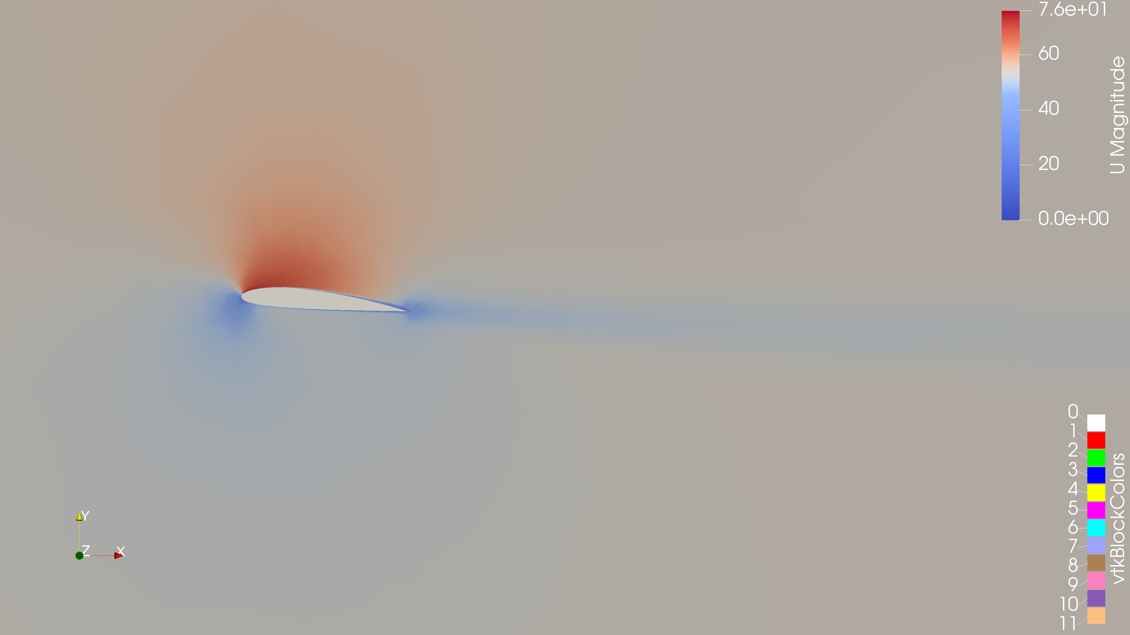
ParaView: the flow around the wing
Velocity magnitude on a midspan slice makes the wing and wake easier to inspect.
10
Notes:
Sources: .\cfd\naca2412\naca2412_run; system/controlDict, system/fvSchemes, system/fvSolution, constant/momentumTransport, constant/physicalProperties, 0/U. Actual case: steady incompressible RANS kOmegaSST with wall functions, SIMPLE, finite AR6 wing at approximately 5 degrees. All flow images must come from the reconstructed 2000 result. The time label is a steady iteration index, not 2000 seconds of physical flow. Source: user 2D_chordwise_velocity_contour.png, velocity magnitude slice at iteration 2000, units m/s. The view shows faster flow over the upper surface and a lower-speed wake downstream. This velocity image alone does not establish flow separation. The vtkBlockColors legend belongs to the separate wing display, not the velocity field. Visual identity: user-supplied Bulldog Motorsports logo; MSU maroon #5D1725, white and gray. Color reference: https://www.brand.msstate.edu/assets/index.php .

Slide 11
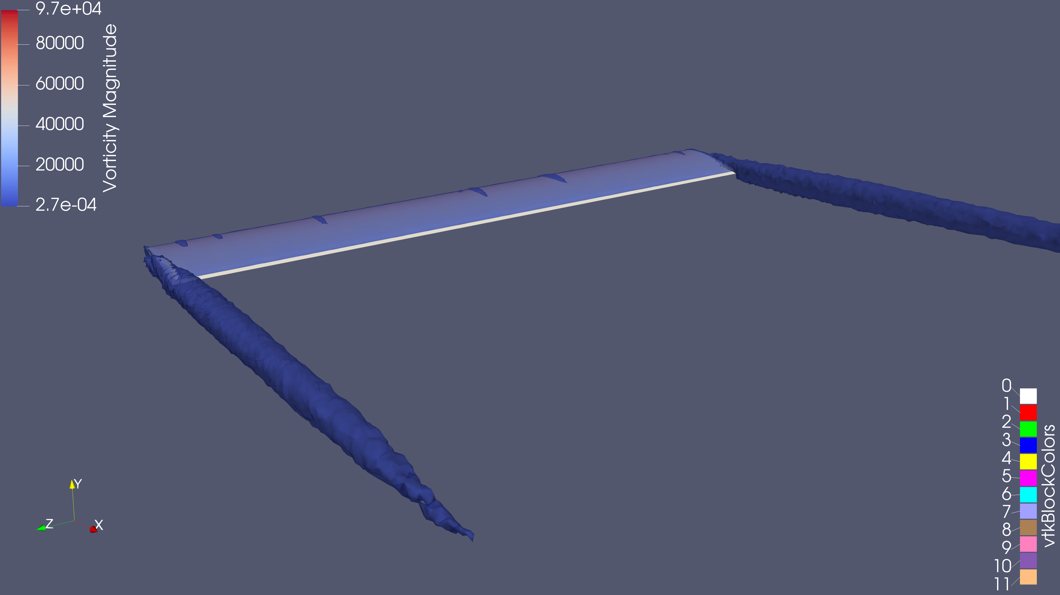
ParaView: a 3D view of the wake
Q = 1,000 s⁻², colored by vorticity magnitude. Tip structures extend into the wake.
11
Notes:
Sources: .\cfd\naca2412\naca2412_run; system/controlDict, system/fvSchemes, system/fvSolution, constant/momentumTransport, constant/physicalProperties, 0/U. Actual case: steady incompressible RANS kOmegaSST with wall functions, SIMPLE, finite AR6 wing at approximately 5 degrees. All flow images must come from the reconstructed 2000 result. The time label is a steady iteration index, not 2000 seconds of physical flow. Source: user angled_q-criterion_vorticies_value1000.png, Q = 1000 s^-2 isosurface, colored by vorticity magnitude in s^-1. The visible structures extend downstream from the wing tips. Positive Q identifies rotation-dominated regions. Steady RANS gives mean structures; it does not resolve transient turbulent eddies. High local gradients and poor cells can produce spurious features, so the image alone does not prove resolved vortex cores. The vtkBlockColors legend refers to the wing display. Visual identity: user-supplied Bulldog Motorsports logo; MSU maroon #5D1725, white and gray. Color reference: https://www.brand.msstate.edu/assets/index.php .

Slide 12
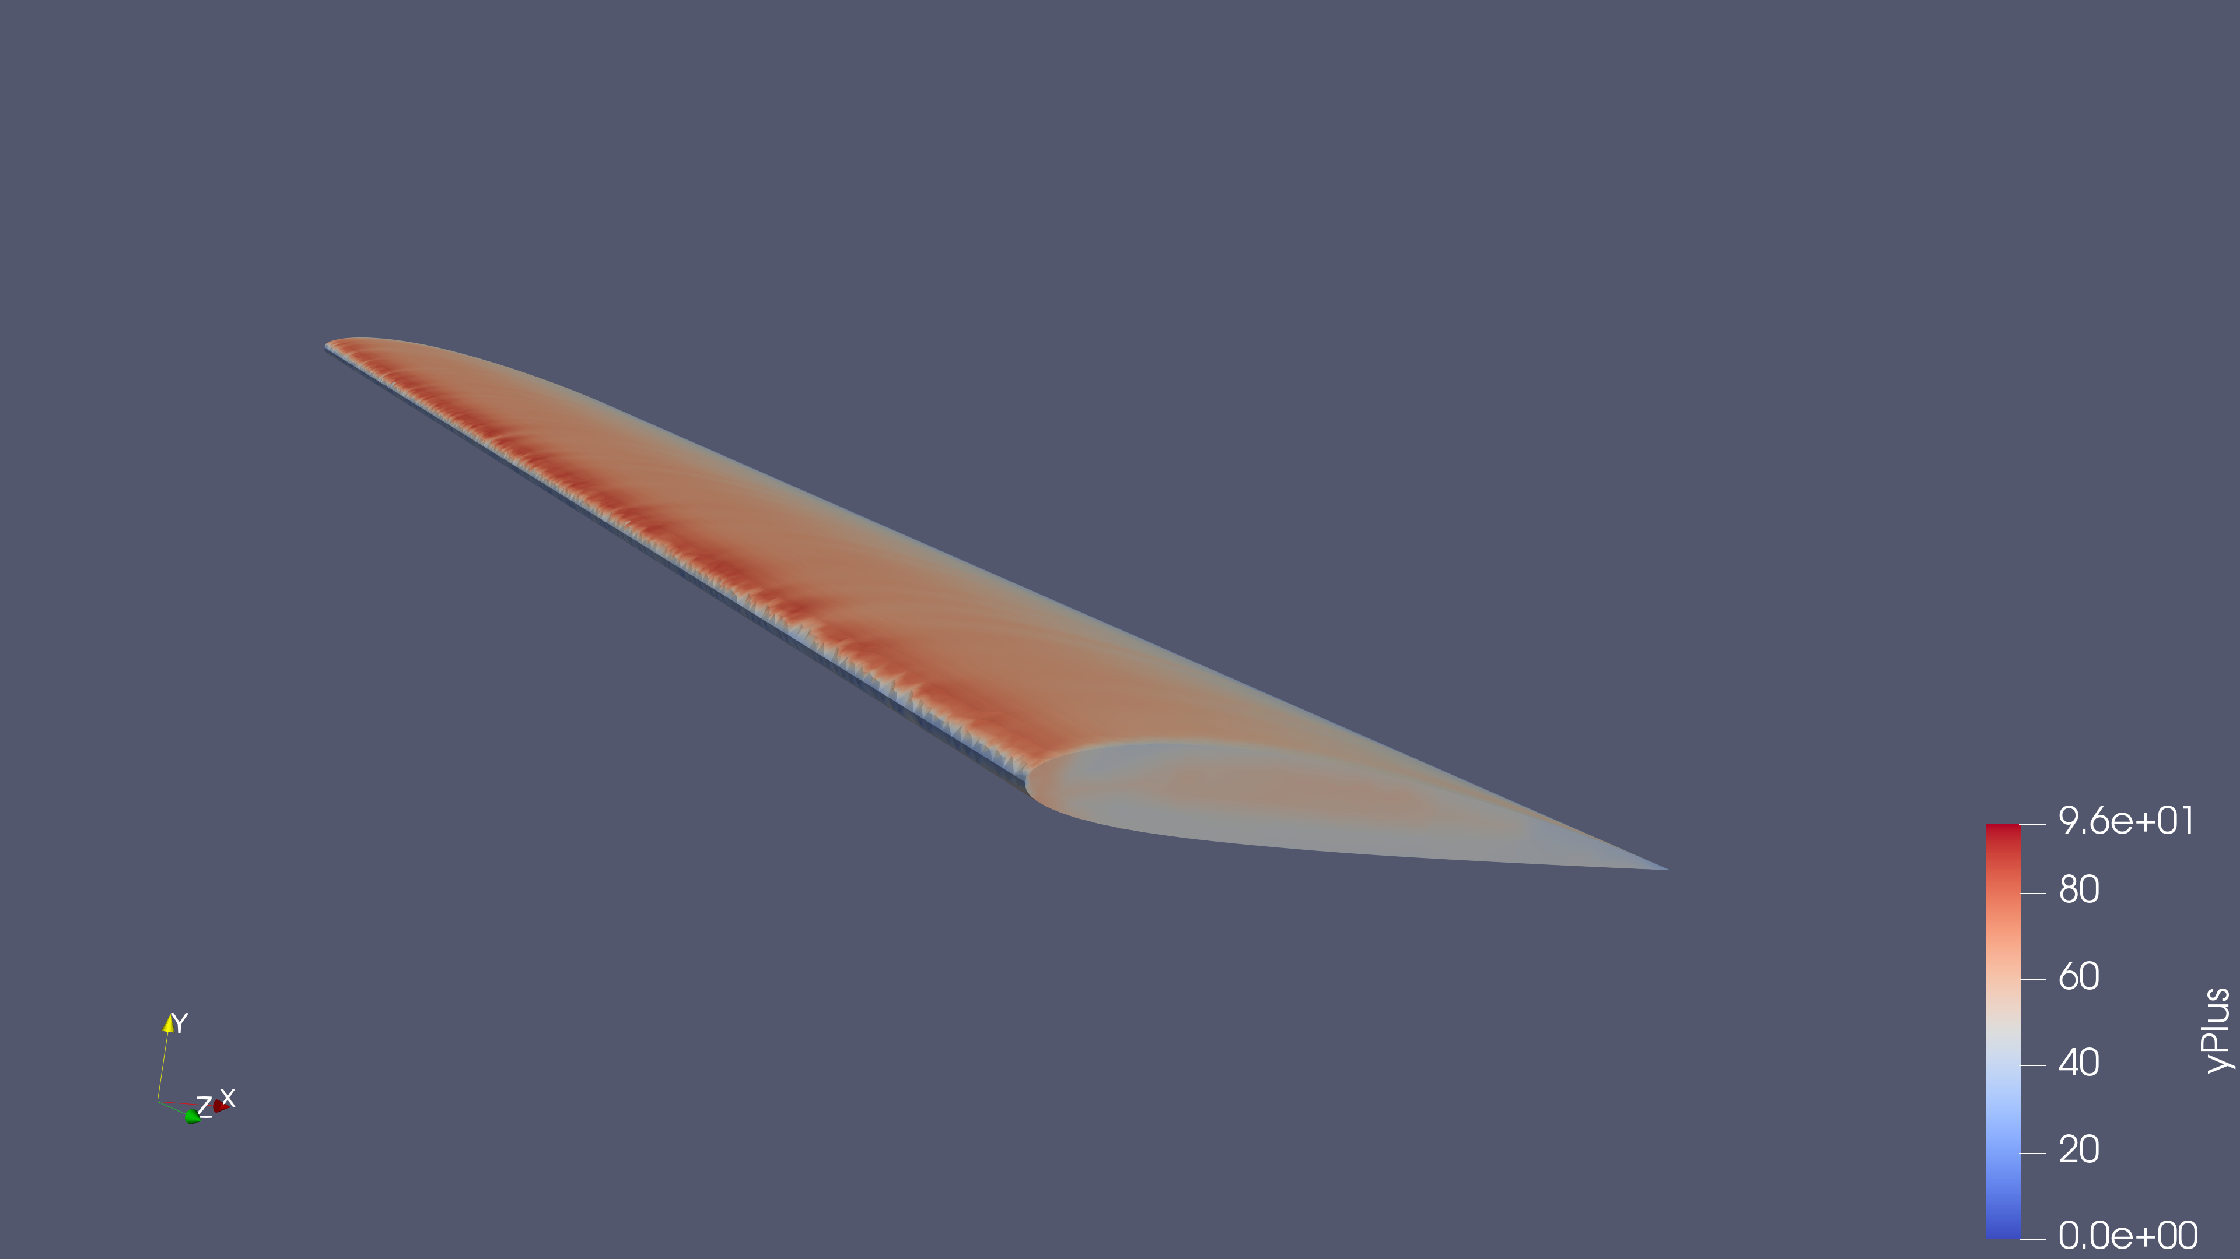
Wall resolution at iteration 2000
52.9
average wing y+
Range: 11.2–95.9
The average is near the target of 50. Local values still need review.
12
Notes:
Sources: .\cfd\naca2412\naca2412_run; system/controlDict, system/fvSchemes, system/fvSolution, constant/momentumTransport, constant/physicalProperties, 0/U. Actual case: steady incompressible RANS kOmegaSST with wall functions, SIMPLE, finite AR6 wing at approximately 5 degrees. All flow images must come from the reconstructed 2000 result. The time label is a steady iteration index, not 2000 seconds of physical flow. Source log.yPlus.2000 and postProcessing/yPlus/2000/yPlus.dat. Wing min 11.1544 max95.8965 average52.8943. defaultFaces min28.8351 max59.1232 avg46.9741. y+ is dimensionless. Target50 in meshing script was an estimate. Conventional log-layer wall-function range should not be claimed for every face, since some areas have y+ below30. Exact wall treatment is model specific. New screenshot only. Visual identity: user-supplied Bulldog Motorsports logo; MSU maroon #5D1725, white and gray. Color reference: https://www.brand.msstate.edu/assets/index.php .

Slide 13
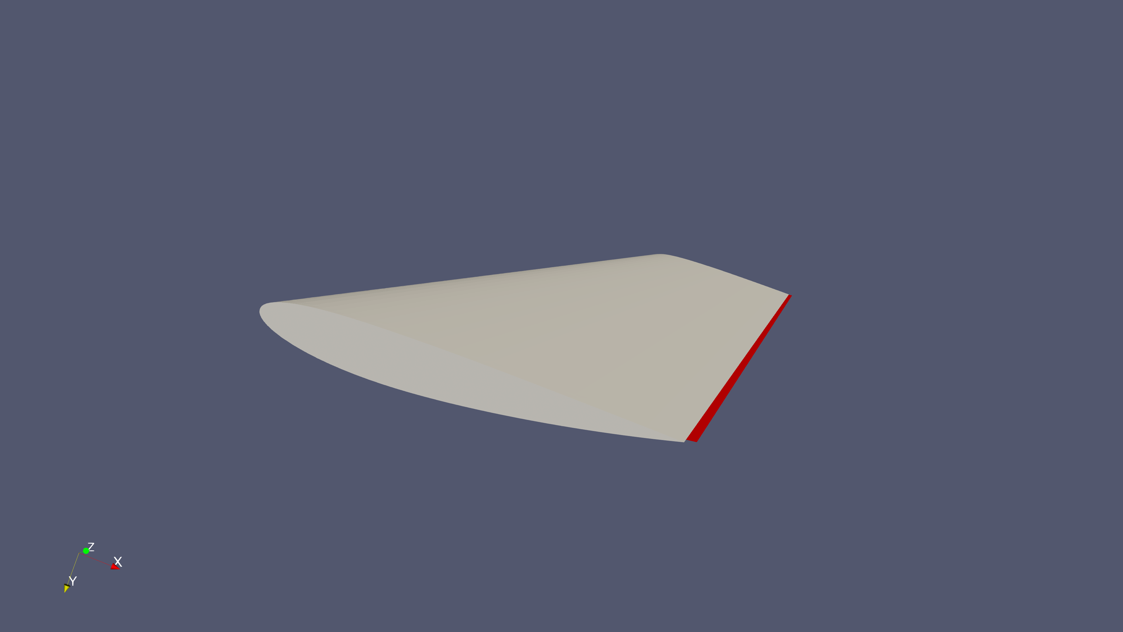
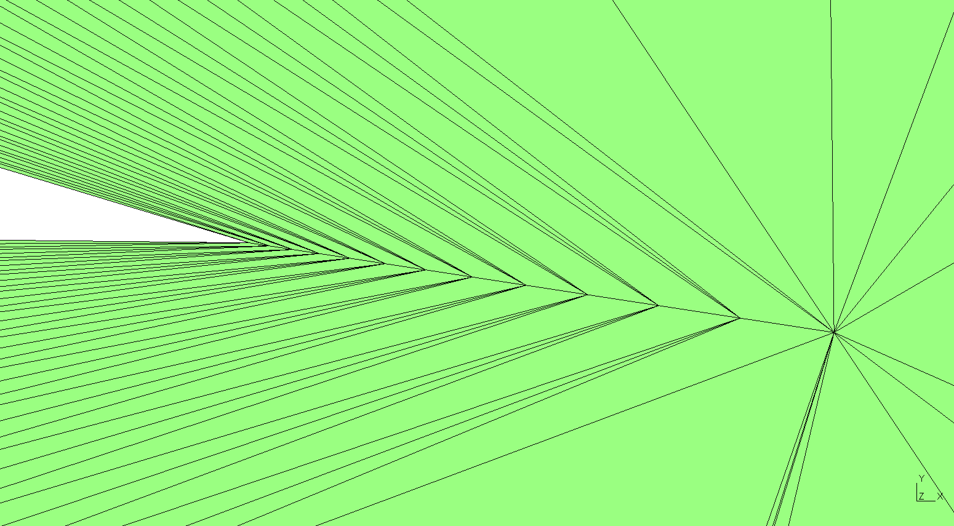
The trailing edge needs a better mesh
Flagged faces along the trailing edge
Gmsh: distorted layers at the sharp edge
2,136 highly skew faces
16.17 maximum skewness
A priority for the next mesh. Its contribution to the drag error is still unproven.
13
Notes:
Sources: .\cfd\naca2412\naca2412_run; system/controlDict, system/fvSchemes, system/fvSolution, constant/momentumTransport, constant/physicalProperties, 0/U. Actual case: steady incompressible RANS kOmegaSST with wall functions, SIMPLE, finite AR6 wing at approximately 5 degrees. All flow images must come from the reconstructed 2000 result. The time label is a steady iteration index, not 2000 seconds of physical flow. Sources: user checkMesh log, skewFaces.vtk and user-observed trailing-edge localization. 2136 highly skew faces, max skewness16.1669. 42 faces above70 degree nonorthogonality, max77.7987. 2 unused points. checkMesh failed skewness and unused-points checks. Positive volumes and successful solution do not remove these limitations. The quality issue is a plausible contributor to drag error, not an established cause. Other contributors may include turbulence/transition assumptions, local discretization, surface fidelity and experimental differences. Plan a controlled before/after mesh comparison. Visual identity: user-supplied Bulldog Motorsports logo; MSU maroon #5D1725, white and gray. Color reference: https://www.brand.msstate.edu/assets/index.php .

Slide 14
A repeatable FSAE design workflow
01 Baseline
Repair the trailing edge, check the mesh and repeat this case.
02 Confidence
Compare three mesh levels and several angles against the experiment.
03 Design studies
Change one wing variable at a time and track downforce, drag and balance.
04 Team handoff
Save CAD, mesh settings, solver files, logs and ParaView states together.
14
Notes:
Sources: .\cfd\naca2412\naca2412_run; system/controlDict, system/fvSchemes, system/fvSolution, constant/momentumTransport, constant/physicalProperties, 0/U. Actual case: steady incompressible RANS kOmegaSST with wall functions, SIMPLE, finite AR6 wing at approximately 5 degrees. All flow images must come from the reconstructed 2000 result. The time label is a steady iteration index, not 2000 seconds of physical flow. Proposed process, not demonstrated full-car capability. Begin with one controlled wing benchmark. Gmsh script changes should be recorded with CAD versions. Keep reference area, force axes and operating conditions consistent when comparing designs. A three-mesh study, angle sweep and physical correlation are proposed acceptance steps, with team-defined tolerances. Visual identity: user-supplied Bulldog Motorsports logo; MSU maroon #5D1725, white and gray. Color reference: https://www.brand.msstate.edu/assets/index.php .

Slide 15
The next step toward the car
Component study
Full-car pilot
Front wing or rear wing
Consistent design comparisons
A documented quality checklist
Moving ground and wheels
Ride height and yaw sweeps
Measured RAM and runtime
What we have demonstrated
A complete local CFD process, experimental comparison and visible paths to improvement.
15
Notes:
Sources: .\cfd\naca2412\naca2412_run; system/controlDict, system/fvSchemes, system/fvSolution, constant/momentumTransport, constant/physicalProperties, 0/U. Actual case: steady incompressible RANS kOmegaSST with wall functions, SIMPLE, finite AR6 wing at approximately 5 degrees. All flow images must come from the reconstructed 2000 result. The time label is a steady iteration index, not 2000 seconds of physical flow. Recommendations for this team, not completed work. Current demonstration is a 2.03M-cell isolated wing on a laptop. A roughly35M-cell full-car case is only an early estimate supplied in discussion; do not extrapolate runtime or RAM linearly. Pilot component and subassembly meshes, measure resources and select hardware. Full-car aero needs appropriate moving ground, rotating wheels and ride height/yaw conditions. OpenFOAM supports those capabilities but this case did not exercise them. Compare Gmsh with OpenFOAM meshing alternatives such as snappyHexMesh if full-car layer generation proves difficult. Retain local or cluster CPU options; no promise of plug-in GPU acceleration. Visual identity: user-supplied Bulldog Motorsports logo; MSU maroon #5D1725, white and gray. Color reference: https://www.brand.msstate.edu/assets/index.php .

